Slide 1
OUR SCHOOL
GYMNAZIUM GELNICA

Slide 2
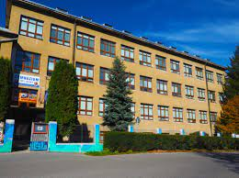
An old part

Slide 3
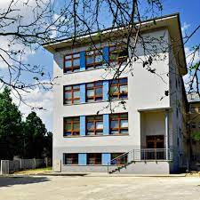
The new part

Slide 4
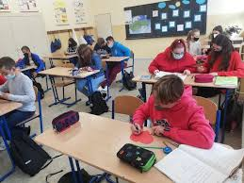
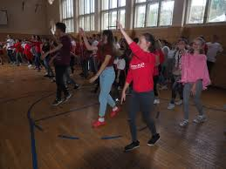
Our classes and a gym

Slide 5
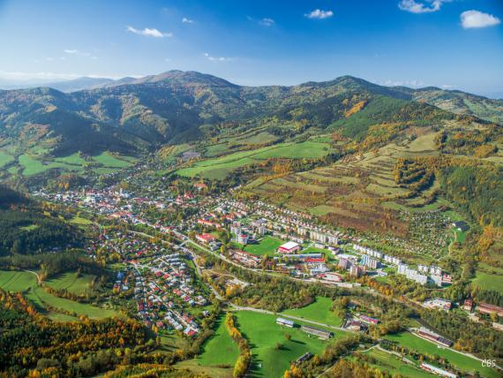
OUR TOWN- GELNICA

Slide 6
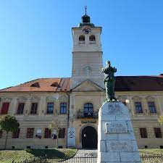
Our museum and a miner statue

Slide 7
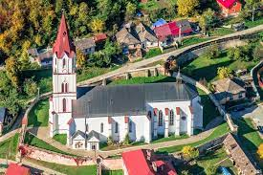
Church

Slide 8
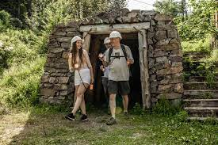
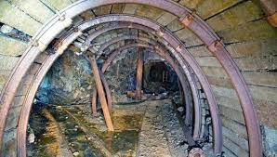
Our mining history 1. Mine Jozef 2. inside of the mine

Slide 9
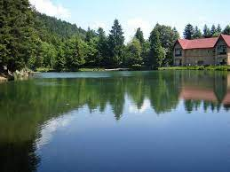
Lake Turzov

Slide 10

Winter in Gelnica

